Slide 1
Practice basic C# types.
Continuous staff improvement
Ion GANDRABURA

Slide 2
OBjectives
Type system in .net
Using arrays
Arrays in General
Declaring Arrays
Initializing Arrays
Accessing Array Members
Using System.Array Methods
Working with strings
Basic String Manipulation
Equality of Strings
Escape Characters and Verbatim Strings
Immutability of Strings
StringBuilder
Examples

Slide 3
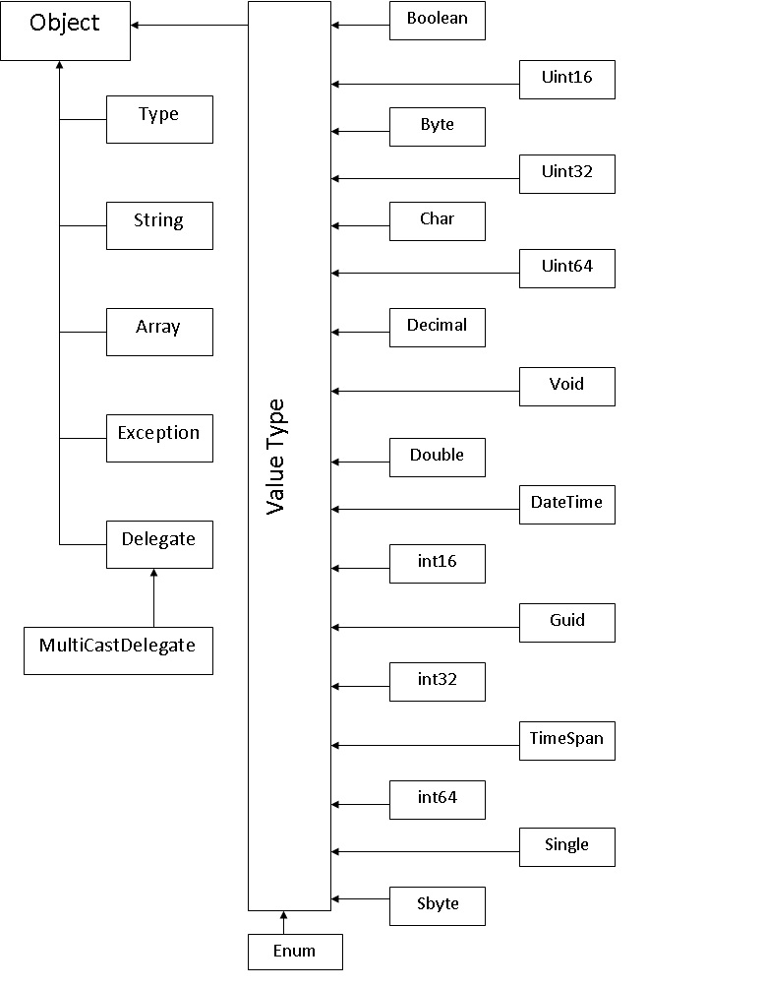
Type system in .net

Slide 4
Using arrays
Arrays in General
C# arrays are zero indexed; that is, the array indexes start at zero. Arrays in C# work similarly to how arrays work in most other popular languages There are, however, a few differences that you should be aware of. When declaring an array, the square brackets ([]) must come after the type, not the identifier. Placing the brackets after the identifier is not legal syntax in C#. int[] table; // not int table[];
Another detail is that the size of the array is not part of its type as it is in the C language. This allows you to declare an array and assign any array of int objects to it, regardless of the array's length.
int[] numbers; // declare numbers as an int array of any size
numbers = new int[10]; // numbers is a 10-element array

Slide 5
Using arrays
Declaring Arrays
C# supports single-dimensional arrays, multidimensional arrays (rectangular arrays), and array-of-arrays (jagged arrays). The following examples show how to declare different kinds of arrays:
Single-dimensional arrays: int[] numbers;
Multidimensional arrays: string[,] names;
Array-of-arrays (jagged): byte[][] scores;
Declaring them (as shown above) does not actually create the arrays. In C#, arrays are objects and must be instantiated.

Slide 6
Using arrays
The following examples show how to create arrays:
Single-dimensional arrays: int[] numbers = new int[5];
Multidimensional arrays: string[,] names = new string[5,4];
Array-of-arrays (jagged): byte[][] scores = new byte[5][];
for (int x = 0; x < scores.Length; x++)
{ scores[x] = new byte[4]; }
You can also have larger arrays. For example, you can have a three-dimensional rectangular array:
int[,,] buttons = new int[4,5,3];
You can even mix rectangular and jagged arrays. For example, the following code declares a single-dimensional array of three-dimensional arrays of two-dimensional arrays of type int:
int[][,,][,] numbers;

Slide 7
Using arrays
Initializing Arrays
C# provides simple and straightforward ways to initialize arrays at declaration time by enclosing the initial values in curly braces ({}). It is important to note that array members are automatically initialized to the default initial value for the array type if the array is not initialized at the time it is declared.
Single-Dimensional Array int[] numbers = new int[5] {1, 2, 3, 4, 5}; string[] names = new string[3] {"Matt", "Joanne", "Robert"};
You can omit the size of the array, like this: int[] numbers = new int[] {1, 2, 3, 4, 5}; string[] names = new string[] {"Matt", "Joanne", "Robert"};
You can also omit the new statement if an initializer is provided: int[] numbers = {1, 2, 3, 4, 5}; string[] names = {"Matt", "Joanne", "Robert"};

Slide 8
Using arrays
Initializing Arrays
Multidimensional Array int[,] numbers = new int[3, 2] { {1, 2}, {3, 4}, {5, 6} }; string[,] siblings = new string[2, 2] { {"Mike","Amy"}, {"Mary","Albert"} };
You can omit the size of the array, like this: int[,] numbers = new int[,] { {1, 2}, {3, 4}, {5, 6} }; string[,] siblings = new string[,] { {"Mike","Amy"}, {"Mary","Ray"} };
You can also omit the new statement if an initializer is provided, like this: int[,] numbers = { {1, 2}, {3, 4}, {5, 6} }; string[,] siblings = { {"Mike", "Amy"}, {"Mary", "Albert"} };

Slide 9
Using arrays
Initializing Arrays
Jagged Array (Array-of-Arrays)
You can initialize jagged arrays like this example: int[][] numbers = new int[2][] { new int[] {2,3,4}, new int[] {5,6,7,8,9} };
You can also omit the size of the first array, like this: int[][] numbers = new int[][] { new int[] {2,3,4}, new int[] {5,6,7,8,9} }; -or- int[][] numbers = { new int[] {2,3,4}, new int[] {5,6,7,8,9} };
Notice that there is no initialization syntax for the elements of a jagged array.

Slide 10
Using arrays
Accessing Array Members
Accessing array members is straightforward and similar to how you access array members in C/C++. For example, the following code creates an array called numbers and then assigns a 5 to the fifth element of the array: int[] numbers = {10, 9, 8, 7, 6, 5, 4, 3, 2, 1, 0}; numbers[4] = 5;
Here code declares a multidimensional array and assigns 5 to the member located at [1, 1]: int[,] numbers = { {1, 2}, {3, 4}, {5, 6}, {7, 8}, {9, 10} }; numbers[1, 1] = 5;
The following is a declaration of a single-dimension jagged array that contains two elements. The first element is an array of two integers, and the second is an array of three integers:
int[][] numbers = new int[][] { new int[] {1, 2}, new int[] {3, 4, 5}}; The following statements assign 58 to the first element of the first array and 667 to the second element of the second array: numbers[0][0] = 58; numbers[1][1] = 667;

Slide 11
Using arrays
Arrays are Objects
In C#, arrays are actually objects. System.Array is the abstract base type of all array types. You can use the properties, and other class members, that System.Array has.
Public Properties
IsReadOnly Gets a value indicating whether the Array is read-only.
IsSynchronized Gets a value indicating whether access to the Array is synchronized (thread-safe).
Length Gets the total number of elements in all the dimensions of the Array.
Rank Gets the rank (number of dimensions) of the Array.
SyncRoot Gets an object that can be used to synchronize access to the Array.

Slide 12
Using arrays
Public Methods
BinarySearch(S) Overloaded. Searches a one-dimensional sorted Array for a value, using a binary search algorithm.
Clear(S) Sets a range of elements in the Array to zero, to false, or to a null reference, depending on the element type.
Clone Creates a shallow copy of the Array.
Copy(S) Overloaded. Copies a section of one Array to another Array and performs type casting and boxing as required.
CopyTo Copies all the elements of the current one-dimensional Array to the specified one-dimensional Array starting at the specified destination Array index.
CreateInstance(S) Overloaded. Initializes a new instance of the Array class.
GetEnumerator Returns an IEnumerator for the Array.
GetLength Gets the number of elements in the specified dimension of the Array.
GetLowerBound Gets the lower bound of the specified dimension in the Array.

Slide 13
Using arrays
GetUpperBound Gets the upper bound of the specified dimension in the Array.
GetValue Overloaded. Gets the value of the specified element in the current Array.
IndexOf(S) Overloaded. Returns the index of the first occurrence of a value in a one-dimensional Array or in a portion of the Array.
Initialize Initializes every element of the value-type Array by calling the default constructor of the value type.
LastIndexOf(S) Overloaded. Returns the index of the last occurrence of a value in a one-dimensional Array or in a portion of the Array.
Reverse(S) Overloaded. Reverses the order of the elements in a one- dimensional Array or in a portion of the Array.
SetValue Overloaded. Sets the specified element in the current Array to the specified value.
Sort(S) Overloaded. Sorts the elements in one-dimensional Array objects.

Slide 14
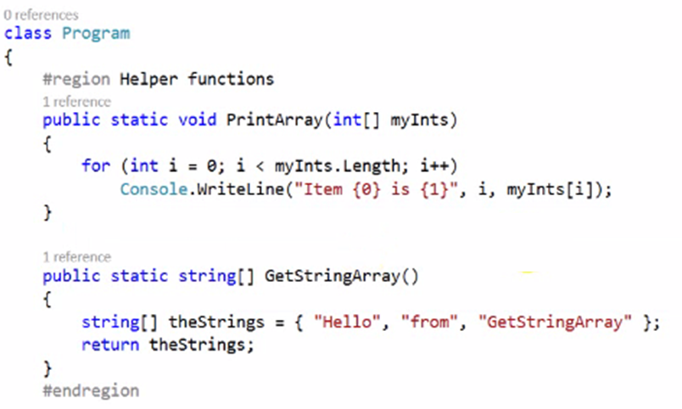
Arrays Examples

Slide 15
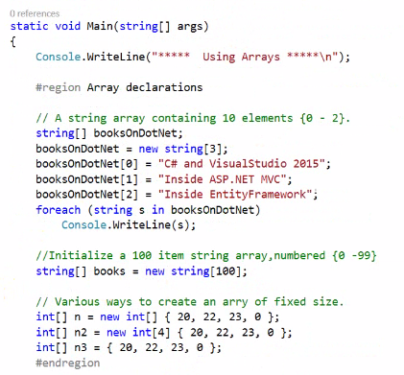
Arrays Examples

Slide 16
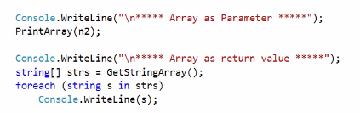
Arrays Examples

Slide 17
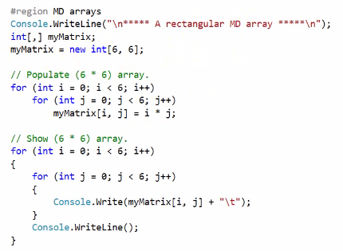

Rectangular Arrays Examples

Slide 18
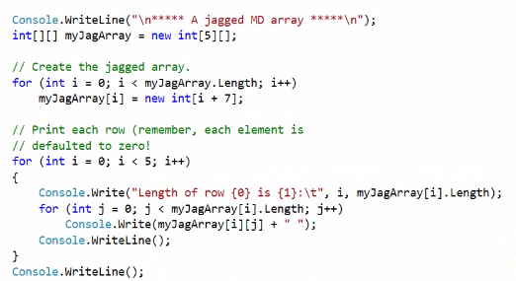

jagged Arrays Examples

Slide 19
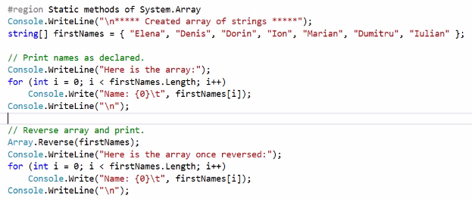
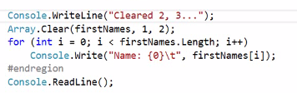

Arrays Methods Examples

Slide 20
Working with strings
Basic String Manipulation
String Member Meaning in Life
Length This property returns the length of the current string.
Compare() This static method compares two strings.
Contains() This method determines whether a string contains a specific substring.
Equals() This method tests whether two string objects contain identical character data.
Format() This static method formats a string using other primitives (e.g., numerical data, other strings) and the {0} notation examined earlier in this chapter.
Insert() This method inserts a string within a given string.

Slide 21
Working with strings
Basic String Manipulation
String Member Meaning in Life
PadLeft() PadRight() These methods are used to pad a string with some characters.
Remove() Replace() These methods are used to receive a copy of a string with modifications (characters removed or replaced).
Split() This method returns a String array containing the substrings in this instance that are delimited by elements of a specified char array or string array.
Trim() This method removes all occurrences of a set of specified characters from the beginning and end of the current string.
ToUpper() ToLower() These methods create a copy of the current string in uppercase or lowercase format, respectively.

Slide 22
Working with strings
String Concatenation
String variables can be connected together to build larger strings via the C# + (as well as +=) operator. As you might know, this technique is formally termed string concatenation.
Escape Characters
As in other C-based languages, C# string literals may contain various escape characters, which qualify how the character data should be printed to the output stream. Each escape character begins with a backslash, followed by a specific token.
Character Meaning in Life
\’ Inserts a single quote into a string literal.
\“ Inserts a double quote into a string literal.
\\ Inserts a backslash into a string literal. This can be quite helpful when defining file or network paths.
\a Triggers a system alert (beep). For console programs, this can be an audio clue to the user.
\n Inserts a new line (on Windows platforms).
\r Inserts a carriage return.
\t Inserts a horizontal tab into the string literal.

Slide 23
Working with strings
Defining Verbatim Strings
When you prefix a string literal with the @ symbol, you have created what is termed a verbatim string . Using verbatim strings, you disable the processing of a literal’s escape characters and print out a string as is.

Slide 24
Working with strings
Strings and Equality
A reference type is an object allocated on the garbage-collected managed heap. By default, when you perform a test for equality on reference types (via the C# == and != operators), you will be returned true if the references are pointing to the same object in memory. However, even though the string data type is indeed a reference type, the equality operators have been redefined to compare the values of string objects, not the object in memory to which they refer.
The C# equality operators perform a case-sensitive, character-by-character equality test on string objects. Therefore, "Hello!" is not equal to "HELLO!", which is also different from "hello!".

Slide 25
Working with strings
Strings Are Immutable
One of the interesting aspects of System.String is that after you assign a string object with its initial value, the character data cannot be changed. At first glance, this might seem like a flat-out lie, given that you are always reassigning strings to new values and because the System.String type defines a number of methods that appear to modify the character data in one way or another (such as uppercasing and lowercasing). However, if you look more closely at what is happening behind the scenes, you will notice the methods of the string type are, in fact, returning you a new string object in a modified format.

Slide 26
Working with strings
The System.Text.StringBuilder Type
The string class can be inefficient and result in bloated code if misused, especially when performing string concatenation or working with huge amounts of text data. If you are building an application that makes heavy use of frequently changing textual data (such as a word processing program), it would be a bad idea to represent the word processing data using string objects, as you will most certainly (and often indirectly) end up making unnecessary copies of string data.
Like the System.String class, the StringBuilder defines methods that allow you to replace or format segments, for example. What is unique about the StringBuilder is that when you call members of this type, you are directly modifying the object’s internal character data (making it more efficient), not obtaining a copy of the data in a modified format. When you create an instance of the StringBuilder, you can supply the object’s initial startup values via one of many constructors. If you are new to the topic of constructors, simply understand that constructors allow you to create an object with an initial state when you apply the new keyword.

Slide 27
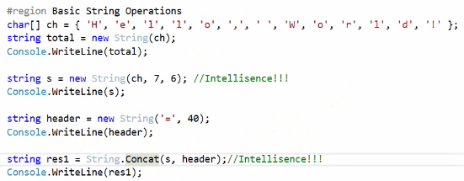

STRING Examples

Slide 28
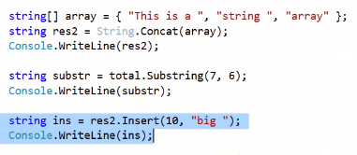

STRING Examples

Slide 29
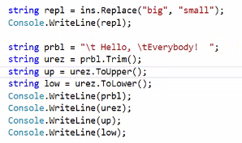

STRING Examples

Slide 30
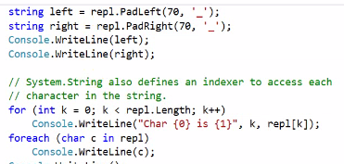
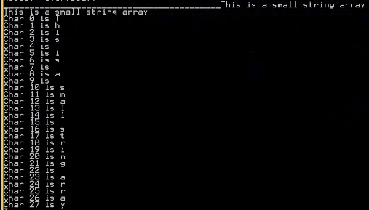
STRING Examples

Slide 31
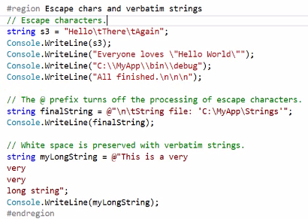
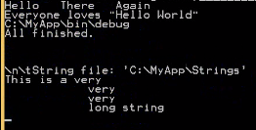
STRING Examples

Slide 32
References
Albahari J, Albahari B (2012). C# 5.0 in a Nutshell.
MSDN

Slide 33
Assignment
Create two functions with one-dimensional arrays
Create two functions with multi-dimensional arrays
Practice with creating new modified strings
Practice with stringbuilder
Create program using split/join methods

